Slide 1
DYNAMIC MEMORY ALLOCATION

Slide 2
Disadvantages of ARRAYS
MEMORY ALLOCATION OF ARRAY IS STATIC:
Less resource utilization.
For example:
If the maximum elements declared is 30 for an array, say int test[30], but the user manipulates with only 10 elements, then the space for 20 elements is wasted.
DIFFERENT DATA TYPES COULD NOT BE STORED IN AN ARRAY

Slide 3
The use of pointer variable instead of arrays, helps in allocation of memory at RUN TIME, thus memory can be allocated or freed anywhere, anytime during the program execution.
    This is known as DYNAMIC MEMORY ALLOCATION

Slide 4
STATIC vs DYNAMIC
  The allocation of memory for the specific fixed purposes of a program in a predetermined fashion controlled by the compiler is said to be static memory allocation.
  The allocation of memory (and possibly its later de allocation) during the run time of a program and under the control of the program is said to be dynamic memory allocation.

Slide 5
Memory Allocation
In DYNAMIC memory allocation, the memory is allocated to the variables in the HEAP region.
The size of HEAP keeps on changing due to creation and death of variables.
Thus it is possible to encounter “memory overflow” during dynamic memory allocation process.
In such situation memory allocation library function returns a NULL pointer when they fail to locate enough memory requested.

Slide 6
Memory Allocation Functions
The following are four memory management functions defined in library of C that can be used for allocation and freeing of memory when ever required.
        malloc
        calloc
        free
        realloc
All the above four functions are defined in library file
<alloc.h>.

Slide 7
malloc ( )
malloc : It is a predefined library function that allocates requested size of bytes and returns a pointer to the first byte of the allocated space.
Pointer returned is of type void that has to be type cast to the type of memory block created (int, char, float, double).
General syntax:
      ptr = (cast –type * ) malloc( byte-size ) ;
      where ptr is pointer of any data type.
      malloc returns a pointer to an area of memory with size byte-size.

Slide 8
Example 1
int *ptr;
ptr = (int *) malloc ( 100 * (sizeof (int ) ) ;
Returns the size of integer
Type cast
Number of elements in the array ptr is pointing to.
Allocate 200 bytes i.e declare an array of 100 integers with pointer ptr pointing to the first element of the array

Slide 9
Alternative
int * ptr ;
printf ( “\n Enter the number of elements in the array “);
scanf(“%d”, &n);
ptr = ( int *) malloc ( n x sizeof ( int ) ) ;
int * ptr ;
ptr = ( int *) malloc ( 200 ) ;

Slide 10
Example 2
char * cptr ;
cptr = ( char * ) malloc ( 10 ) ;
This will allocate 10 bytes of memory space for the pointer cptr of type char.
cptr pointer holding the address of the first byte of the array of 10 elements
? ? ? ? ? ? ? ? ? ?
10 bytes of space

Slide 11
Important
The storage space allocated dynamically has NO name and therefore its contents are accessed ONLY through a pointer.
malloc allocates blocks of contiguous memory locations.
If allocation fails due to in sufficient space on HEAP, it returns NULL pointer. Thus when ever we allocate memory it should be checked whether the memory has assigned successfully or not.

Slide 12
Exercise
Write a program to create an array of integers. Size of the array that is number of elements in the array will be specified interactively by the user at RUN TIME.
Read 10 Values in an array that has been created runtime and print the same.

Slide 13
SOLUTION
#include<alloc.h>
int main( ) {
int *p, *table, size ;
printf(“\n Enter the size of array “);
scanf(“%d”, &size);
/* memory allocation */
table = (int * ) malloc ( size * (sizeof (int))
if(table == NULL )
{ printf(“\n NO space available “);
exit(1);
}
printf(“\n Address of first byte is %p”, table);

Slide 14
Visualization
If size = 10 => 20 bytes will be allocated.
Integer pointer * table pointing to first element of array

Slide 15
SOLUTION cont’d: Reading values in the array
// reading values in array
printf(“\n Input table value “);
for( p= table; p<table + size ; p++)
scanf(“%d”, p );
// printing values of array in reverse order
for( p = table+size – 1 ; p >= table ; p-- )
printf(“%d”, *p);

Slide 16
Visualization
for( p= table; p<table + size ; p++)
scanf(“%d”, p );
table
pointer * p
pointer * p
pointer * p

Slide 17
Printing values in reverse order
for( p = table+size – 1 ; p >= table ; p-- )
printf(“ %d”, *p);
* table
pointer * p
pointer * p
pointer * p

Slide 18
OUTPUT
What is the size of array ? 5
Address of first byte : 077FA
Input values: 11 12 13 14 15
OUTPUT values in reverse order
15
14
13
12
11

Slide 19
calloc ( )
calloc ( ): It also allocates the requested number of bytes, but the difference is that it takes two parameters:
        N : number of elements
        Element_size: size of element in bytes
Also when the memory is allocated, all the elements are assigned a initial value of zero.
        This is not provided by function malloc ( )
General syntax:
ptr = (cast _type * ) calloc (n, element_size);

Slide 20
The above statement allocates contiguous space for n elements, each of size element_size.
All elements are initialized to zero and a pointer to the first byte of the allocated region is returned.
If there is not enough space, a NULL pointer is returned.

Slide 21
Releasing the Used Space
In case of Dynamic RUN Time allocation, it is the responsibility of the programmer to release the memory space when it is not required by the program.
When a block of data in memory is no longer needed by the program, it should be released as memory is a factor in executing complex programs.

Slide 22
free ( )
To release the memory currently allocated to a pointer using DYNAMIC ALLOCATION use the following function:
free ( ptr );
where ptr is a pointer to a memory block which has already been created using either malloc or calloc .

Slide 23
Altering the size of memory block
REALLOCATION function (realloc)

Slide 24
Example
If the original allocation was done by the statement:
ptr = (cast_type * ) malloc ( size ) ;
Then REALLOCATION of space is done by :
ptr = (cast_type * )realloc ( ptr, NEW_SIZE );

Slide 25
How It works ? ? ?
This function allocates a new memory space of size NEW_SIZE to the pointer variable ptr and returns a pointer to the first byte of the new memory block.
The NEW_SIZE may be larger or smaller than the original size.
The new block of memory MAY or MAY NOT begin at the same place as the previously allocated memory block.

Slide 26
The function guarantees that the old data will remain intact, if it run successfully.
If the function is unsuccessful in locating additional space, it returns a NULL pointer and the original block is FREED [ lost ] .

Slide 27
Memory allocation function
If memory allocation fails, these functions return a NULL pointer.
Since these functions return a pointer to void, when allocating memory use conversion:
  pi = (int*)malloc(5*sizeof(int)); /* or */
  pi = (int*)calloc(5, sizeof(int));
  pi = (int*)realloc(pi, 10*sizeof(int));

Slide 28
Exercise
Write a program to store a character string in a block of memory space created by malloc and then modify the same to store a larger string.

Slide 29
SOLUTION
int main(void)
{ char * buffer ;
/* allocating memory */
if( (buffer = (char *) malloc (10 ))== NULL )
{ printf(“ NOT ENOUGH SPACE “ );
exit (1 ); }
strcpy(buffer, “ NOIDA “ );
/* reallocating space */
if ( (buffer = (char *) realloc( buffer, 15 ) ) == NULL )
{ printf(“ REALLOCATION FAILS “);
exit (1 );}

Slide 30
printf(“ Buffer contains : %s”, buffer );
strcpy( buffer, “ JIIT,Noida”);
Printf(“ Buffer contains : %s “, buffer );
/* freeing the memory */
free ( buffer );
}

Slide 31
Example
#include <stdio.h>
#include <stdlib.h>
int main()
{
char *str; /* Initial memory allocation */
str = (char *) malloc(15);
strcpy(str, “example");
printf("String = %s, Address = %u\n", str, str);
/* Reallocating memory */
str = (char *) realloc(str, 25);
strcat(str, “of realloc");
printf("String = %s, Address = %u\n", str, str);
free(str);
return(0);
}

Slide 32
output
String = example, Address = 355090448
String = example of realloc, Address = 355090448

Slide 33
An example: Using Dynamically Allocated Storage
int i, *pi;
float f, *pf;
pi = (int *) malloc(sizeof(int));
pf = (float *) malloc (sizeof(float));
*pi =1024;
*pf =3.14;
printf(”an integer = %d, a float = %f\n”, *pi, *pf);
free(pi);
free(pf);
request memory
return memory
Allocation and deallocation of pointers
CHAPTER 4

Slide 34
Two dimensional Array
In the same manner it is also possible to create a two dimensional array at RUN TIME using malloc ( ) or calloc ( ).
For creating a two dimensional array, declare a pointer as follows:
data_type ** pointer ;
example:
int **p;

Slide 35
Example: creating a 2D array of m rows and n columns.
int main()
{ int **ptr;
int m, n;
printf(“\n Enter the number of rows:”);
scanf(“%d”, &m);
printf(“\n Enter the number of columns:”);
scanf(“%d”, &n);
/* creating an array of m pointers */
ptr = (int**) malloc ( m *sizeof(int*));
/* allocating each pointer a row ( 1 D array) */
for (i = 0; i < m; i++)
ptr[i] = (int *)malloc( n * sizeof(int));

Slide 36

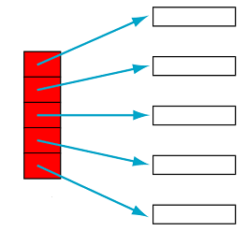
int **ptr
ptr[0]
ptr[1]
ptr[2]
ptr[3]
ptr[4]

Slide 37
Check This Out !!!
Is it possible to create a TWO Dimensional array with m rows, where each row will have different number of columns ? ? ?
YES ! ! !

Slide 38
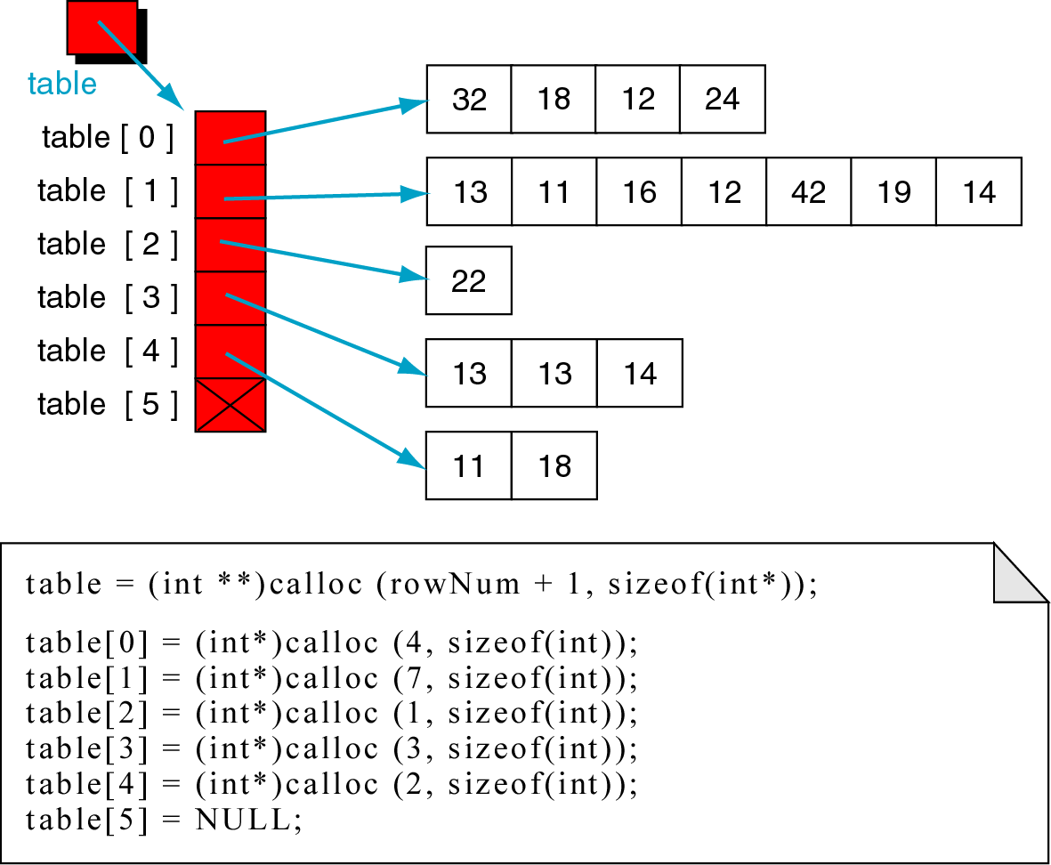
Visualization

Slide 39
Advantages
There are number of reasons for using pointers:
    Pointers are more efficient in handling data tables.
    Pointer reduces the length and complexity of a given problem.
    Pointer increase the execution speed.
    The use of a pointer array to character strings results in saving of data storage space in memory.

